Slide 1

BRACT’S, Vishwakarma Institute of Information Technology, Pune-48
(An Autonomous Institute affiliated to Savitribai Phule Pune University)
(NBA and NAAC accredited, ISO 9001:2015 certified)
Path Finding Algorithm
Name | Roll No. | PRN | E-mail
Aditya Dhanraj Kalbhor | 221005 | 22110053 | aditya.22110053@viit.ac.in
Sanwara Chandak | 221014 | 22110035 | sanwara.22110035@viit.ac.in
Prasad Chate | 221015 | 22110212 | prasad.22110212@viit.ac.in
Atharva Chaudhri | 221016 | 22110675 | Atharva.22110675@viit.ac.in
Om Deore | 221022 | 22110318 | Om.22110318@viit.ac.in

Slide 2
Contents
Depth First Search
Breadth First Search
Dijkstra's Algorithm
Code explanation
Few more Application

Slide 3
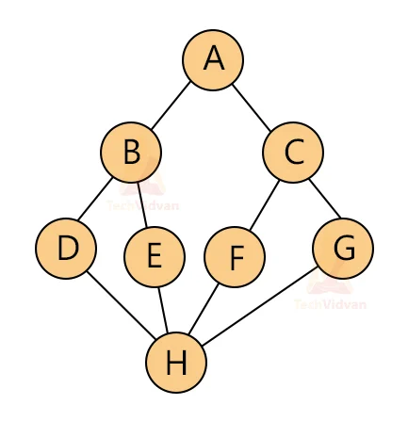
Depth First Search
Depth-first search (DFS) is an algorithm for traversing or searching tree or graph data structures.
The algorithm starts at the root node (selecting some arbitrary node as the root node in the case of a graph) and explores as far as possible along each branch before backtracking.
Extra memory, usually a stack, is needed to keep track of the nodes discovered so far along a specified branch which helps in backtracking of the graph.
Time Complexity: O(V+E)

Slide 4
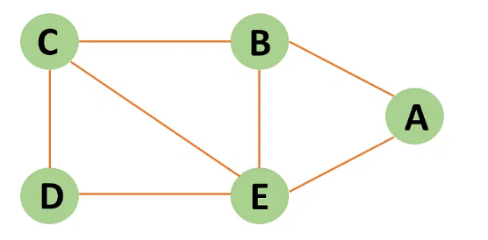
Breadth First Search
Breadth-first search is a graph traversal algorithm that starts traversing the graph from the root node and explores all the neighboring nodes.
Then, it selects the nearest node and explores all the unexplored nodes. While using BFS for traversal, any node in the graph can be considered as the root node.
Time complexity: O(V+E); Vis vertices & E is edges
Lets understand it with example:

Slide 5
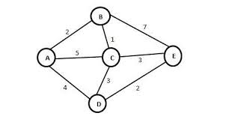
Dijkstra’s Algorithm
Dijkstra’s algorithm is used to find the shortest path between the two mentioned vertices of a graph by applying the Greedy Algorithm as the basis of principle.
Time complexity: O(V^2);
(V is no. of vertices)
Lets understand it with an example :

Slide 6
Code

Slide 7
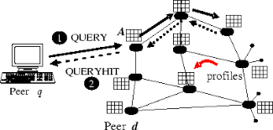
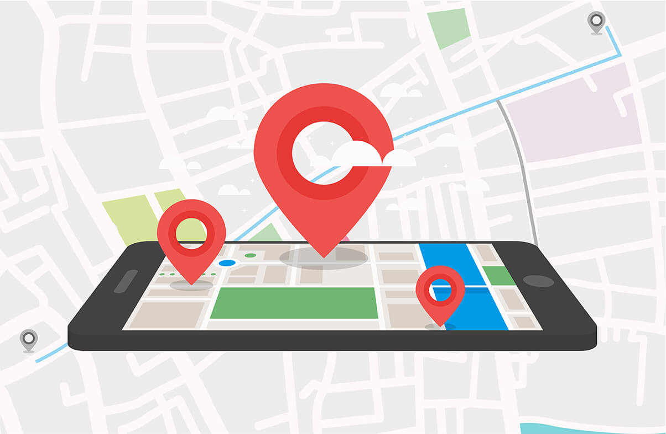
Application
BFS:
Peer to Peer Networks
GPS Navigation systems
In Garbage collection

Slide 8
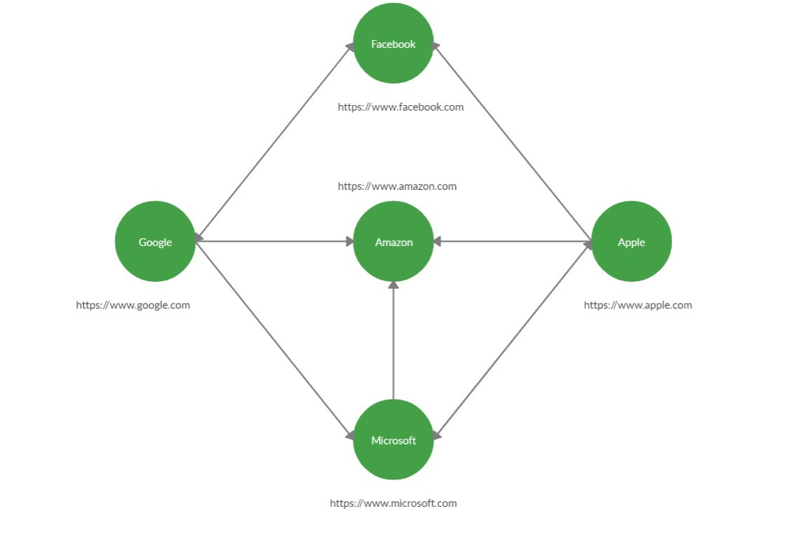
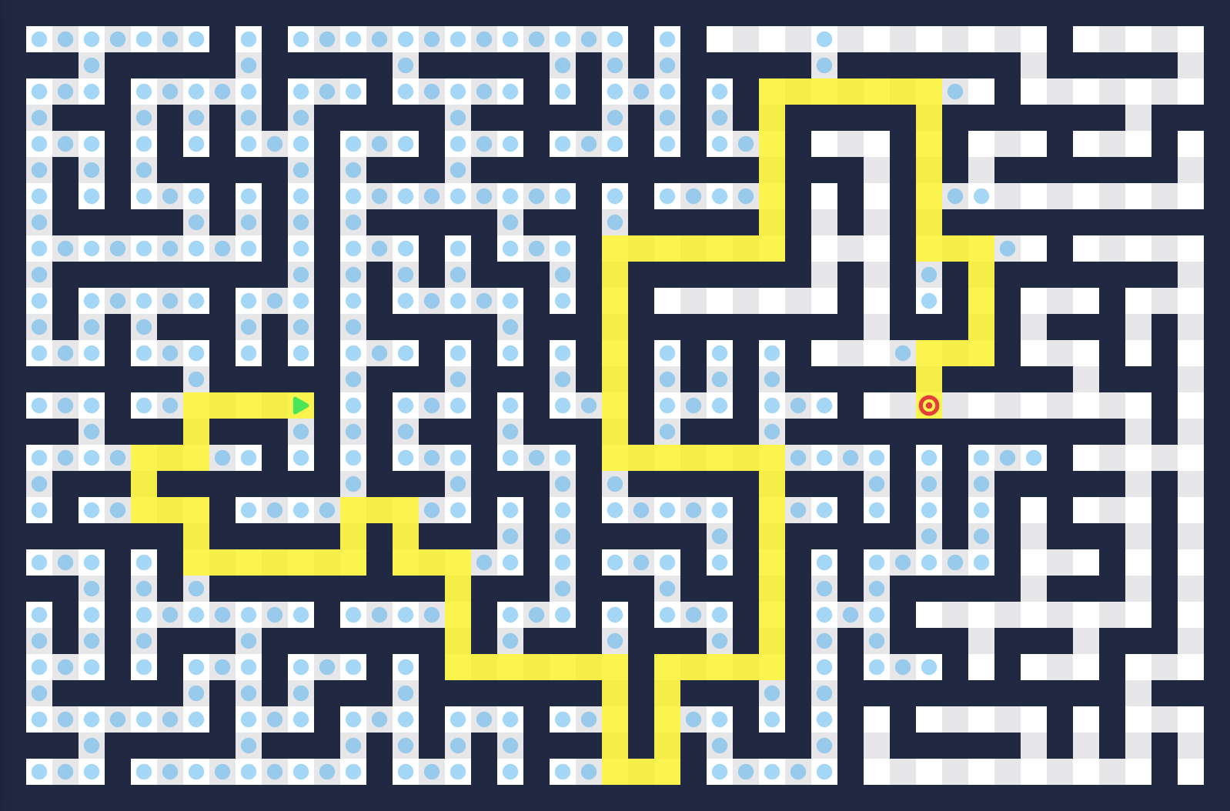
Application
DFS:
Solving puzzles with only one solution
Web crawlers
Maze generation

Slide 9
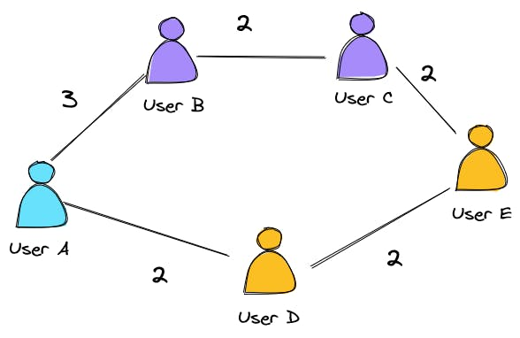
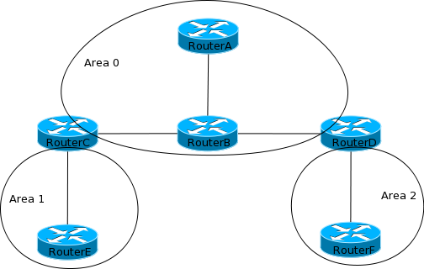
Application
Dijkstra’s Algorithm:
Digital Mapping Services in Google Maps
Social Networking Applications
IP routing to find Open shortest Path First

Slide 10
Thank You

